Slide 1
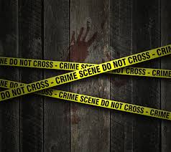
CRIME DATA ANALYSIS
AISHWARYAA A
MBE 10

Slide 2
Count | Education level
11895 | High unemployment
12132 | No high school diploma
4116 | Associate degree
5153 | High school graduate
50077 | Invalid rate (both exceeds 100 & NA)
1436 | Bachelor’s degree
197 | Graduate degree
Insights about educational level

Slide 3
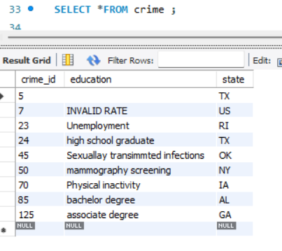
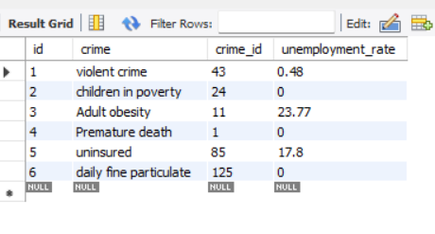
SQL JOINS OF THE CRIME DATA ANALYSIS
TABLE 1 (confusion)
TABLE 2 (crime)

Slide 4
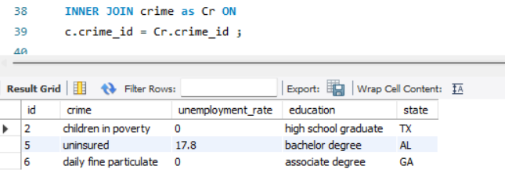
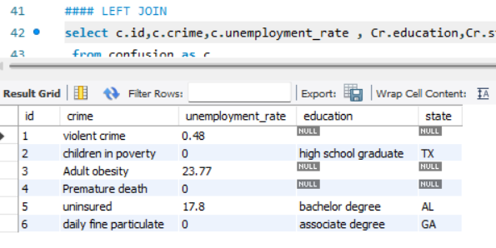
INNER JOIN :
Only matching rows from both tables.
LEFT JOIN :
Useful when you want to retain all records from the left table, regardless of whether there is a matching record in the right table.

Slide 5
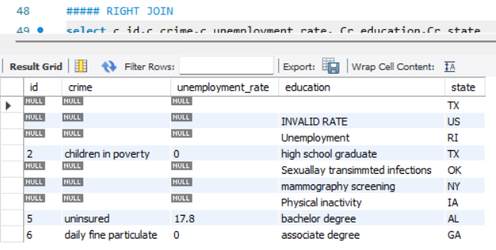
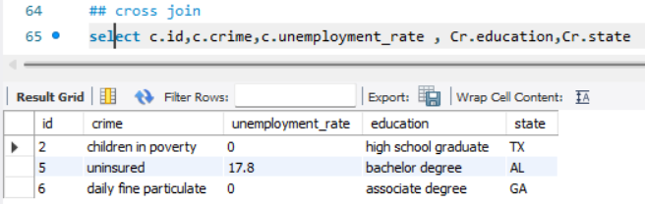
RIGHT JOIN :
Returns all rows from the right table and the matched rows from the left table.
If there is no match, NULL values are returned for columns from the left table.
CROSS JOIN :
when you want to generate all combinations of data from two tables

Slide 6
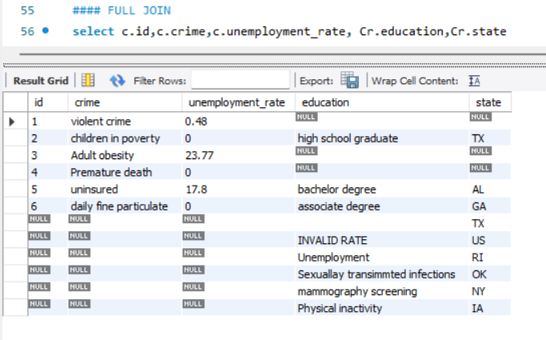
FULL JOIN :
All rows from both tables, with NULLs where there are no matches.

Slide 7
CRIME TYPE BRIEF
Violent crime encompasses offenses such as homicide, assault, robbery, and sexual assault. Understanding why people commit these crimes involves a combination of social, psychological, and economic factors
Reasons: Socioeconomic Factors : Poverty, unemployment.
Exposure to Violence, Mental Health Issues
Adult obesity the relationship between obesity and crime is complex and multifaceted. While obesity itself is a health issue, it can intersect with crime in various ways, particularly regarding societal behaviors, socioeconomic status, and mental health.
Reasons :Social Stigma and Discrimination, Mental Health Issues.
Children living in poverty are at a heightened risk for involvement in criminal activities, both as victims and offenders.
Reasons :Limited Access to Resources, Exposure to Violence, Family Stress.
Daily Fine particulate matter (PM2.5) refers to airborne particles that are 2.5 micrometers or smaller, which can originate from various sources such as vehicle emissions, industrial discharges, and household activities.
Reasons :Health Impacts, Cognitive Functioning, Social Stressors

Slide 8
Diabetic screening involves testing individuals for diabetes to promote early diagnosis and management. While not directly linked to crime, issues surrounding access to healthcare, including diabetic screening, can intersect with crime rates, particularly in socioeconomically disadvantaged communities.
Reasons: Health Disparities, Economic Stress, Access to Healthcare.
Mammography screening is a key tool for early detection of breast cancer, but access to these services can be limited by various socio-economic factors, leading to health disparities. While mammography itself is not directly linked to crime, issues surrounding healthcare access can intersect with criminal behavior, particularly in marginalized communities.
Physical inactivity refers to insufficient engagement in physical exercise or activity, which can have significant health implications. While not directly a cause of crime, patterns of physical inactivity can correlate with criminal behavior, particularly in socioeconomically disadvantaged areas.
Reasons :Lack of Opportunities, Social Isolation.
Premature death refers to fatalities that occur before the average age of death in a population, often due to preventable causes such as violence, substance abuse, accidents, or chronic health issues. The relationship between premature death and crime is complex, as crime can be both a cause and a consequence of premature death.
Reasons :Violence and Homicide, Substance Abuse( Substance use disorders are linked to both crime and premature death )

Slide 9
Preventable hospital stays refer to admissions that could have been avoided with timely and effective outpatient care, management of chronic conditions, or preventive measures. The relationship between preventable hospitalizations and crime is complex, often influenced by socioeconomic factors, access to healthcare, and community resources.
Sexually transmitted diseases (STDs) encompass a range of infections that are primarily transmitted through sexual contact. While STDs themselves are medical issues, they can intersect with crime in various ways, particularly concerning public health, personal behavior, and socio-economic factors.
Reasons :Lack of Education and Awareness:, Stigma and Discrimination.
Unemployment refers to the situation when individuals who are capable of working are unable to find employment. The relationship between unemployment and crime is complex, as economic instability can lead to increased crime rates in various communities.
Reasons :Economic Desperation, Opportunity Structures, Peer Influence.
Being uninsured refers to individuals lacking health insurance coverage, which can have significant implications for health outcomes and socioeconomic stability. The relationship between being uninsured and crime is multifaceted, as lack of access to healthcare can contribute to criminal behavior in various ways.
Reasons : Social Isolation, Healthcare Access

Slide 10
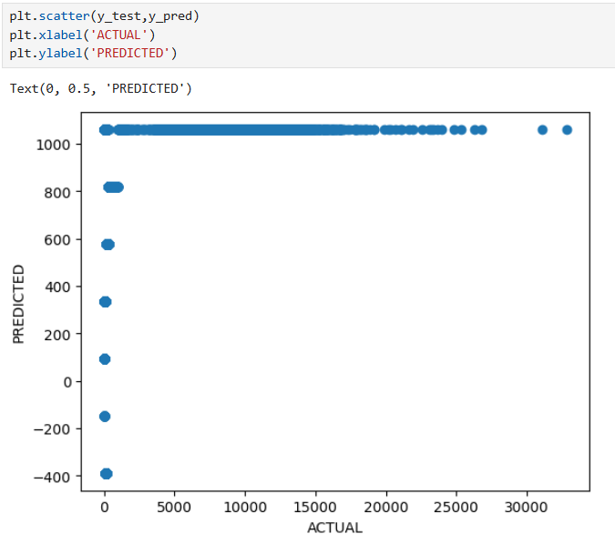
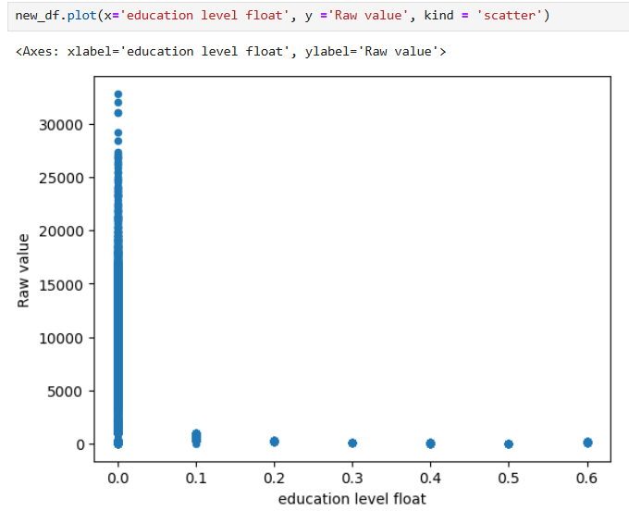
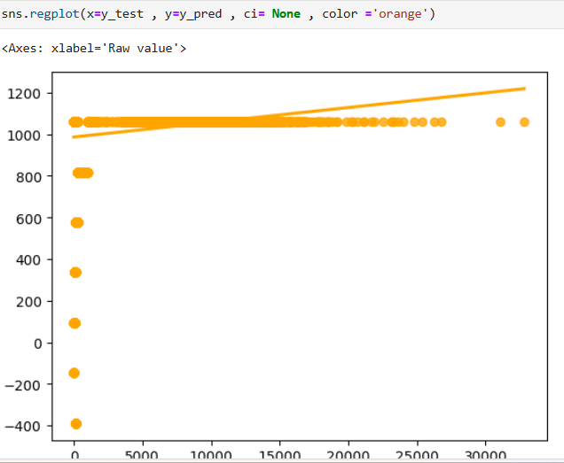
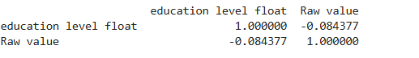
Linear regression between the educational level and its crime rate

Slide 11
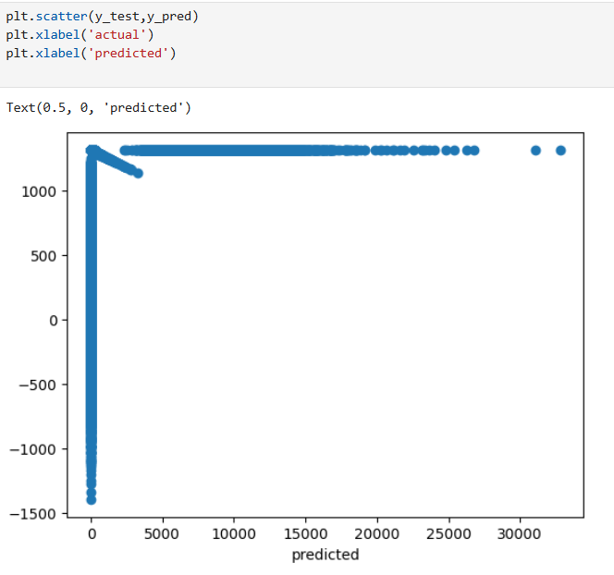
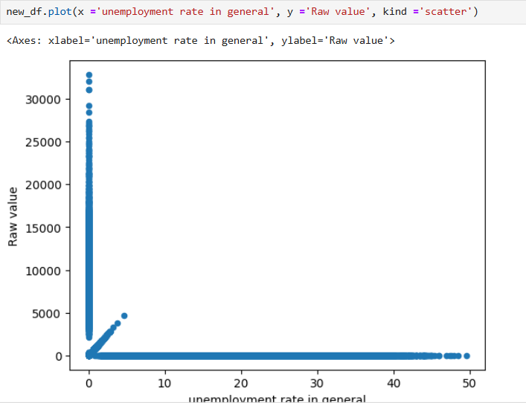
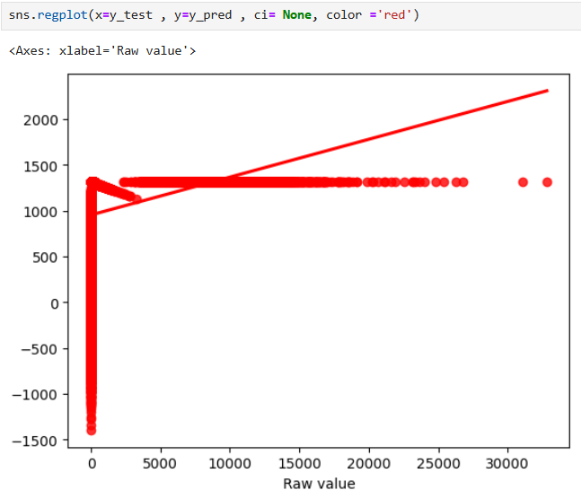
Linear regression between the unemployment rate and its violent crime rate
The weak correlation suggests that other variables may be influencing crime rates more significantly than unemployment alone. Factors such as economic conditions, social programs, policing strategies, community engagement, and demographics might play a larger role.

Slide 12
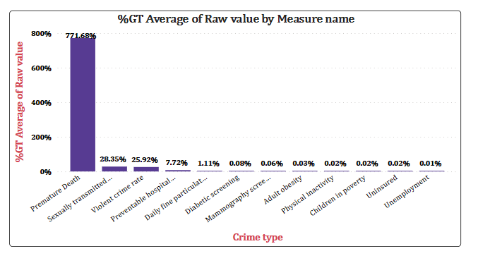
Insights are valuable for decision-making, resource allocation, and strategic planning in law enforcement or community safety initiatives.
Impact of different crime types on communities can aid in crafting policies or interventions tailored to specific issues, enhancing their effectiveness.
Premature death (771.68%)

Slide 13
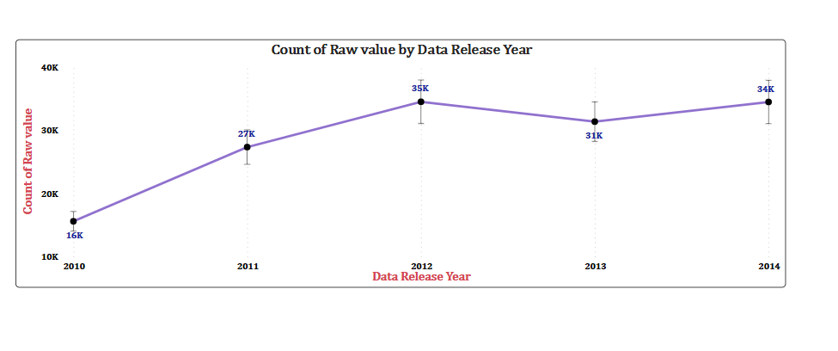
Confidence intervals help illustrate the variability in the data. A year with a narrow confidence interval indicates more consistent reporting or occurrence, while a wider interval suggests greater uncertainty or variability.
Visualization not only highlights trends but also emphasizes the reliability and variability of the data, supporting more nuanced and informed decision-making processes.
2012 (35k)

Slide 14
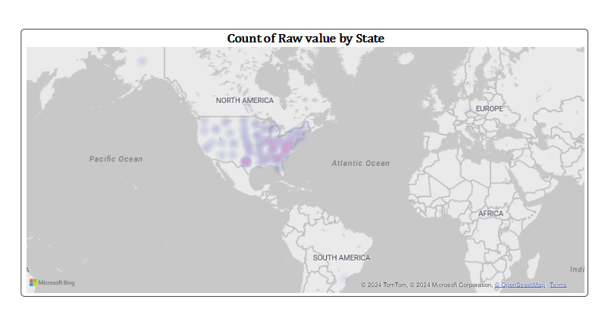
States with intense colors indicate hotspots where incidents are more prevalent. This can help the areas needing urgent intervention.
A heat map provides an intuitive and impactful way to visualize and understand complex data, making it easier to communicate findings to stakeholders and drive informed decision-making.

Slide 15
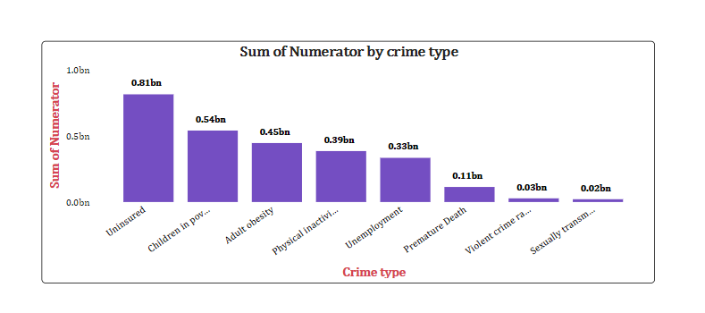
This visual offers a straightforward way to grasp the scale and impact of various crime types, guiding data-driven decision-making and resource allocation.
Total counts for each crime type can inform law enforcement and community organizations about where to focus their efforts, such as increasing patrols in areas with higher crime rates.
Uninsured (0.81bn)
Children in poverty (0.54 )

Slide 16
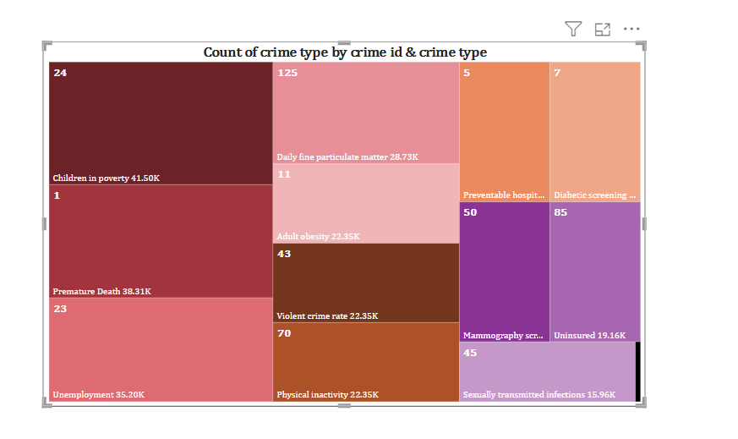
Each crime type is visually represented in proportion to its count, allowing for quick identification of which crimes are most prevalent. Larger blocks indicate crime types with higher counts, pinpointing areas that may require more immediate attention or resources
Children in poverty (41.50k)
Premature death
Unemployment (36.20k)

Slide 17
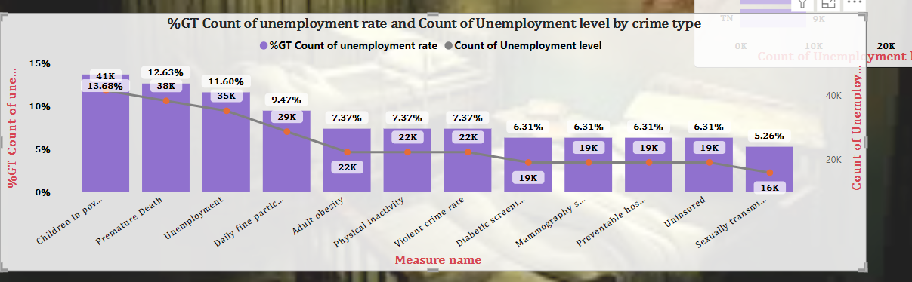
High unemployment levels associated with certain crime types might indicate deeper social issues that require targeted intervention and support.
These insights can inform strategies to address both crime and unemployment, promoting holistic community improvement.
Unemployment rate & level : children in poverty

Slide 18
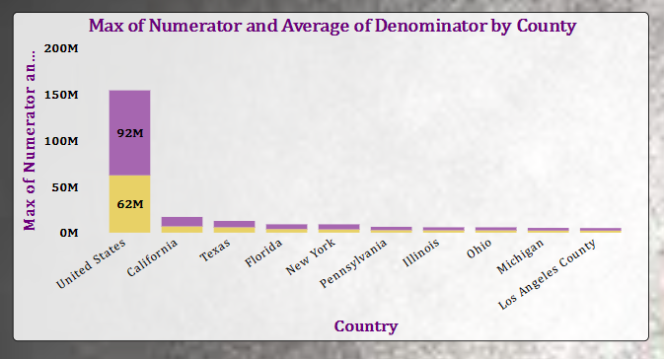
The maximum numerator indicates which countries experience the highest peak crime incidents, highlighting urgent areas for law enforcement focus.
This can help assess the effectiveness of crime reduction strategies and inform future initiatives.
United states
California
Texas

Slide 19
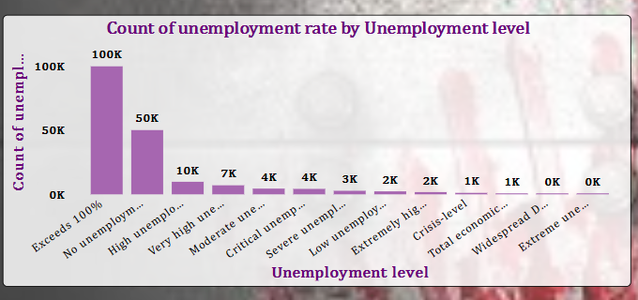
Understanding which unemployment levels correlate with higher crime counts can help identify vulnerable populations that may be more prone to criminal activity due to economic factors.
These highlights emphasize the interplay between economic conditions and crime.
Exceeds 100% (In extreme cases, during severe economic crises or hyperinflation, a region might face such dramatic shifts in employment that figures appear nonsensical, though this wouldn't literally translate to an unemployment rate over 100%.)

Slide 20
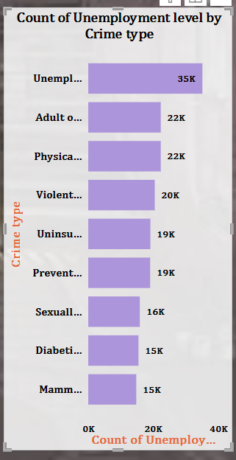
Correlation Between Property Crimes and Unemployment
Higher unemployment rates may correlate with increased property crimes, such as theft and burglary. This could suggest that individuals facing economic hardship may resort to these crimes out of necessity or desperation.
Result : Job training programs and economic support
Rise in Violent Crimes Among the Unemployed
There might be a significant link between unemployment and certain types of violent crimes, indicating that social stressors and lack of economic opportunities can lead to increased aggression or violence.
Result :Mental health support and conflict resolution,

Slide 21
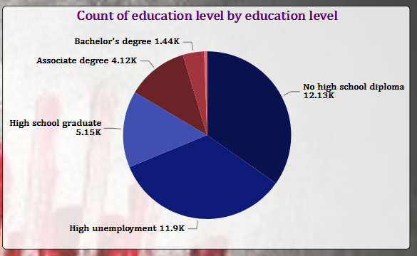
The distribution of education levels among populations can reveal disparities that may correlate with crime rates, highlighting communities with lower educational attainment that may be more vulnerable to crime.
This insight can guide resource allocation towards educational initiatives in high-crime areas, promoting long-term strategies for reducing crime through improved education.
No high school diploma
High unemployment

Slide 22
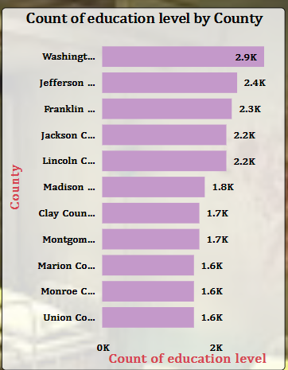
Comparing education levels across countries can help identify successful educational policies that contribute to lower crime rates, providing models for other nations.
Insights into education levels by country can uncover the socioeconomic factors that influence crime, facilitating more targeted and effective crime reduction strategies.
WASHINGTON
JEFFERSON

Slide 23
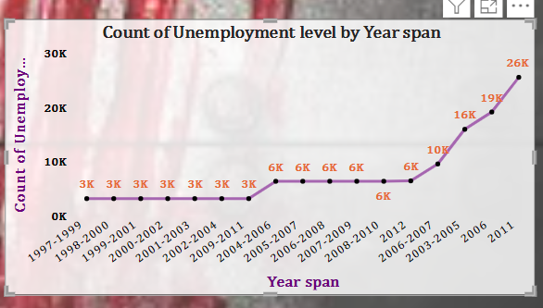
This insight Helps to understand economic impacts on criminal behavior.
Spikes in unemployment during specific years may coincide with increases in crime, indicating periods of economic distress that warrant targeted intervention.

Slide 24
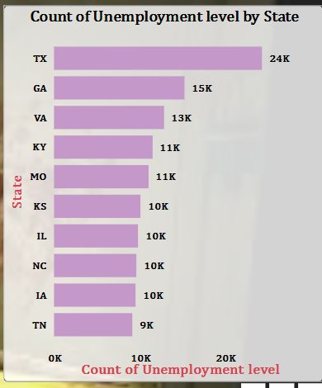
.
This provides the areas that needs support, fostering collaboration to address both economic and crime-related challenges.
Unemployment levels across states can help evaluate the effectiveness of local policies aimed at job creation and crime reduction
TX(Texas)
GA(Georgia)
VA (Virginia)

Slide 25
Difference between the unemployment level analyzed by STATE and COUNTRY ..
Count of Unemployment Level by State
Granular Analysis: Provides detailed insights into specific regions, allowing for targeted crime prevention strategies that address local economic conditions.
Regional Trends: Highlights variations in unemployment across states, helping to identify specific areas with high unemployment that may correlate with increased crime rates.
Count of Unemployment Level by Country
Broad Trends: Offers a macro-level view of unemployment, revealing global patterns and trends that can influence international crime dynamics.
Comparative Analysis: Allows for comparisons between countries, helping to identify which nations have successfully managed unemployment and its impact on crime.
State-level analysis offers specificity and immediate applicability, country-level analysis provides context and broader trends, both of which are vital for a nuanced approach to crime analysis.

Slide 26
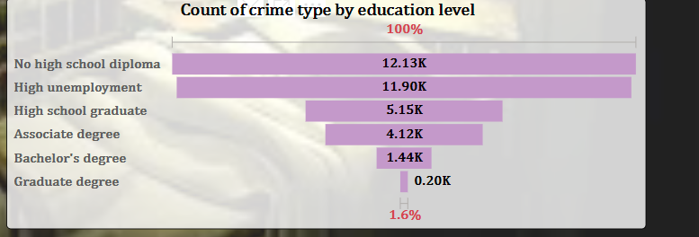
Highlighting specific education levels associated with increased crime can help identify at-risk groups, allowing for targeted outreach and support services.
Analyzing crime types by education level provides a deeper understanding of the socioeconomic factors influencing crime, facilitating a more comprehensive approach to crime reduction.
No high school diploma
High unemployment

Slide 27
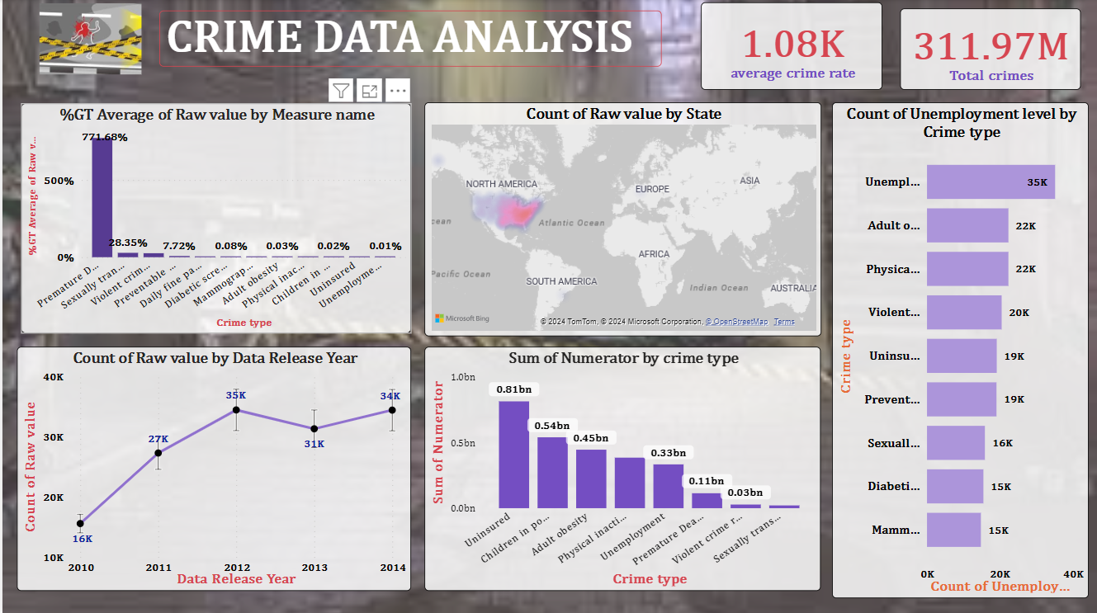

Slide 28
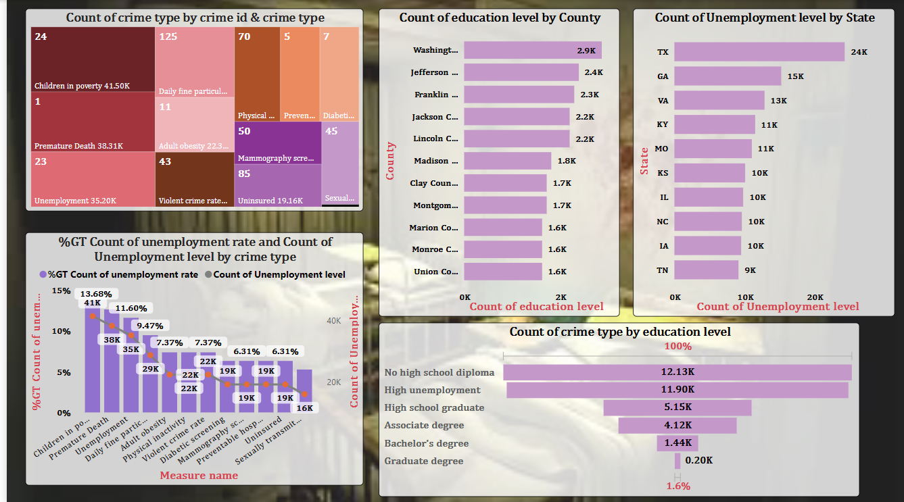

Slide 29
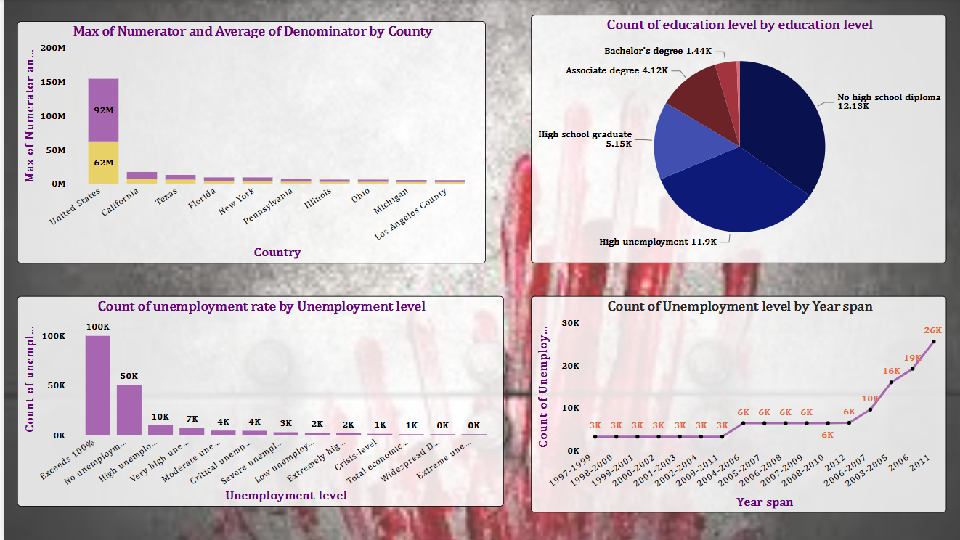

Slide 30

There are crimes that, like frost on flowers, in one single night destroy character and reputation.
HENRY WARD BEECHER
THANK YOU

